Slide 1

Drift and Diffusion current
The current that flows across a semiconducting crystal has
two components
Drift current
Diffusion current
Dr. S. RANJITH / Physics, SRM IST

Slide 2
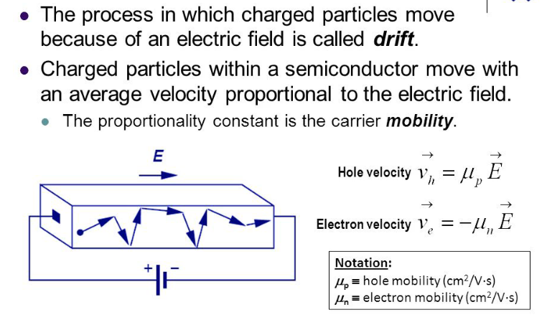
Carrier Drift
Dr. S. RANJITH / Physics, SRM IST

Slide 3
DRIFT CURRENT
In a perfect (defect free) crystal and the periodic electric field enables electron
and holes to move freely in a vacuum.
The defects in real crystals cause the periodic electric field to be disturbed and
for T>0 K, thermal energy can be considered to cause the lattice ions to vibrate.
These imperfections cause scattering of the free carriers resulting in
finite conductivity
In the absence of any externally applied electric field, the random motion
of free carriers within a crystal does not result in a net transfer of charge since
Charge movement in any direction is balanced by charge movement in any other
Direction
When a voltage is applied across the material, each carrier experience a force attracting
It to one end of the material, electrons being attracted to the positive potential due
To their negative charge and holes to the negative potential.
This net movement in charge carriers termed drift is superimposed on the
Random thermal movement and results in current flow through the crystal.
Dr. S. RANJITH / Physics, SRM IST

Slide 4
The electric current density is given by
J=nev_{d ;} v_{d} is the drift velocity
The conductivity is
σ = J/E = (nev_{d} /E)
σ = (ne /E)(eEτ/m) with v_{d =} (eEτ/m)
σ = (ne²τ/m)
Where τ is the relaxation time between collisions
Again v_{d =} μ E
Where, the parameter μ is the mobility of charge carrier within the crystal.
Thus, J = nev_{d} = ne μ E
σ = J/E = ne μ
or in terms of resistivity ρ
ρ = 1/ σ = 1/ ne μ
If the material is a semiconductor, the current flow would be due to electron and hole movement.
Dr. S. RANJITH / Physics, SRM IST

Slide 5
Correspondingly the current densities due to electron drift and hole are:
J_{n} (drift) = n μ_{n} eE
J_{p} (drift) = p μ_{p} eE
J (drift) = J_{n} (drift) + J_{p} (drift)
J (drift) = n μ_{n} eE + p μ_{p} eE
Comparison with J = σ E
σ = n μ_{n} e + p μ_{p} e
For an intrinsic semiconductor n = p = n_{p}
σ_{i =} n_{i}e(μ_{n +} μ_{p} )
Dr. S. RANJITH / Physics, SRM IST

Slide 6
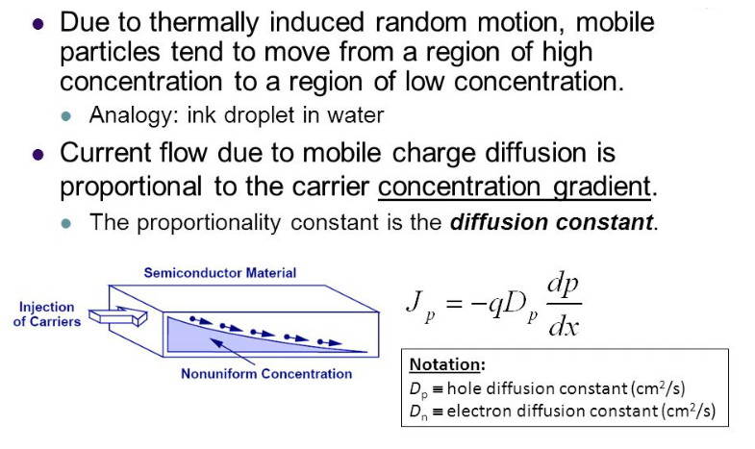
Carrier Diffusion
Dr. S. RANJITH / Physics, SRM IST

Slide 7
Diffusion Current
The drift motion of the carriers under the influence of an electric field the carriers
in semiconductors may move by diffusion.
Diffusion occurs whenever there is a non-uniform concentration of charge carriers
at some places of the crystal.
The excess carriers move from the region of higher density to region of lower
density tending to produce a uniform distribution. The transport mechanism
is called diffusion and it takes place in addition to drift caused by an applied
electric field.
If the gas molecules were electrically charged, the net flow of charge would
result in a diffusion current.
Dr. S. RANJITH / Physics, SRM IST

Slide 8
Let us suppose that the concentration Δn of electrons varies with distance x
In the semiconductor, the concentration of gradient being
d(Δn) /dx
Fick’s law states that the rate at which carriers diffuse is proportional to
The density gradient and the movement is in the direction of negative
Gradient, the rate of flow of electrons is proportional to
d(Δn) /dx
From which the rate of flow across unit area is got, equal to
-D_{n} d(Δn) /dx , Where D_{n} is the diffusion coefficient for electron
J_{n}( diffusion) = -(e) (rate of flow across unit area)
= eD_{n} d(Δn) /dx
Dr. S. RANJITH / Physics, SRM IST

Slide 9
If an excess hole concentration is created in the same region, hole
Diffusion takes place in the same direction at a rate per unit area
= - D_{p} d(Δp) /dx
Resulting in a hole diffusion current density.
J_{p}( diffusion) = +(e) (rate of flow across unit area)
= - eD_{p} d(Δp) /dx . Where D_{p} is the hole diffusion coefficient
If there is an electric field E and a concentration gradient in the x-direction,
the total hole current is the sum of the drift current.
J_{p} = J_{p} (drift) + J_{p} (diffusion)
J_{p} = peμ_{p} - eD_{p} d(Δp) /dx
Similarly for electrons, the total current density
J_{n} = neμ_{n} + eD_{n} d(Δn) /dx
Dr. S. RANJITH / Physics, SRM IST

